Slide 1

Deep Learning Crash Course
Hui Xue
Fall 2021
www.deeplearningcrashcourse.org

Slide 2
Outline
Vanilla RNN and backprop through time
Variation of RNNs
LSTM and GRU
Multi-layer RNN and bidirectional RNN
Sequence pre-processing

Slide 3

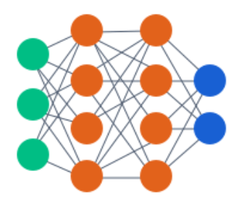
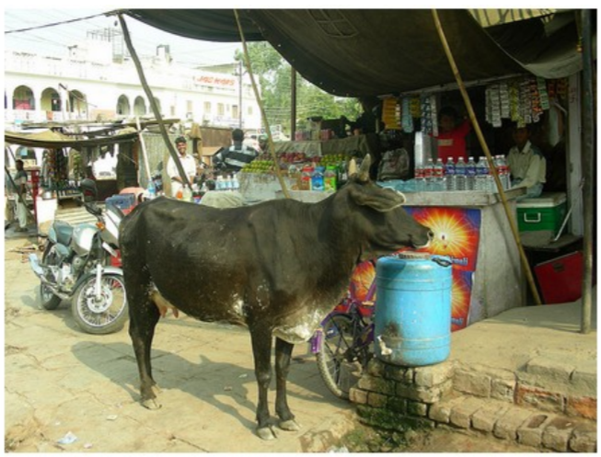
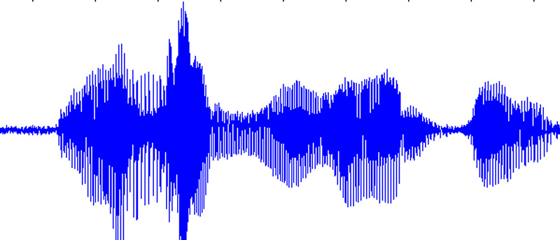


So far, one-to-one mapping
Image Captioning
Sentimental classification
Speech recognition
Machine translation
$$\hat{y}$$
a cow is standing in the middle of a street
Today is nice. Let’s go to the park.
今天天气很好。我们去公园吧。
$$x$$
Image
Video with fixed length
Tabulate feature set
…
Three weeks ago, I bought this product. It worked fine at the beginning but stopped working after a week ..
Today is nice. Let’s go to the park.
https://cs.stanford.edu/people/karpathy/sfmltalk.pdf

Slide 4
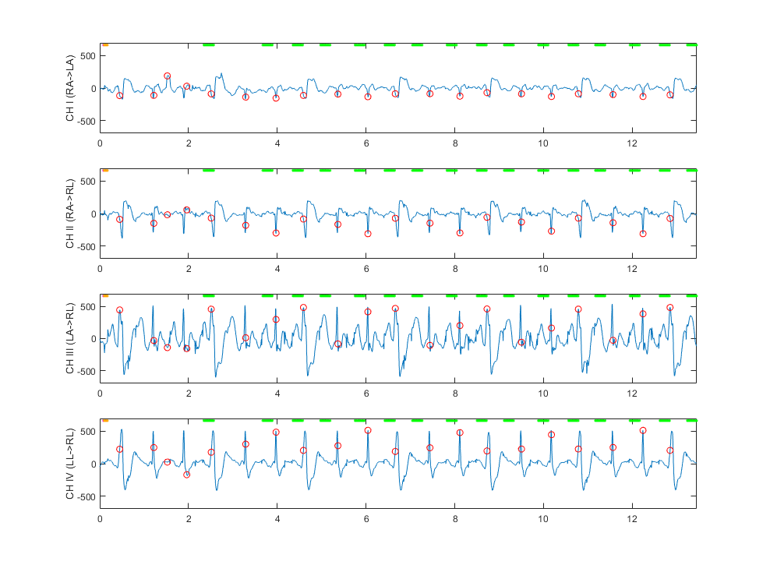
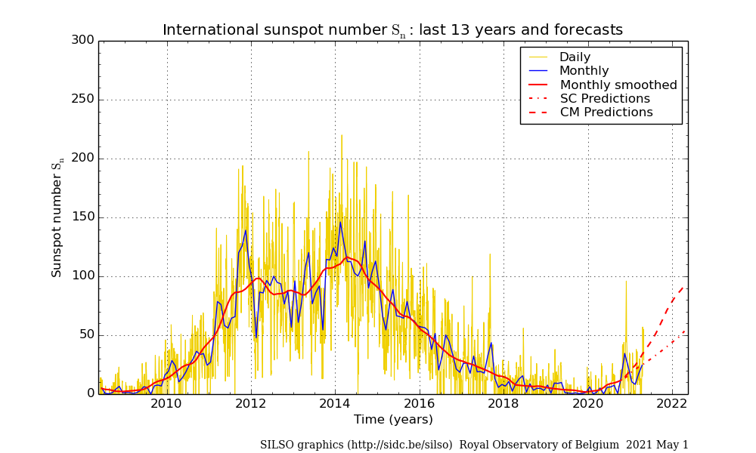
Sequence model for regression or detection
Regression to estimate the number of sunspots
Detect R-wave trigger from ECG waveform
http://www.sidc.be/silso/dayssnplot

Slide 5
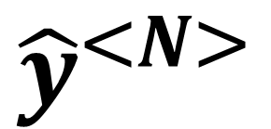
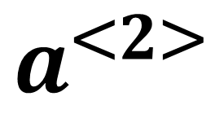
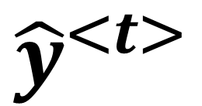
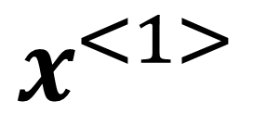
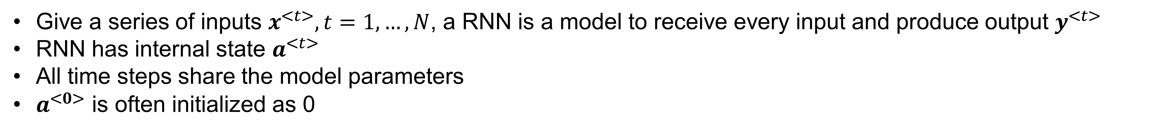
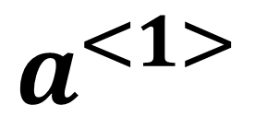
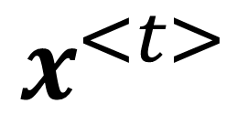
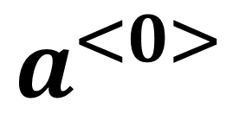
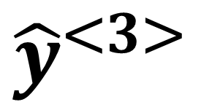
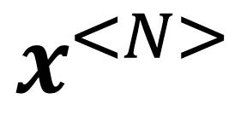
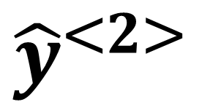
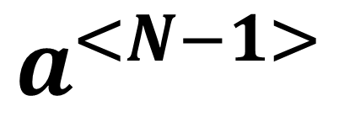
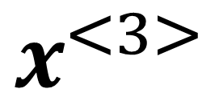
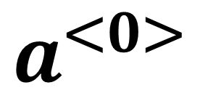
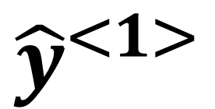
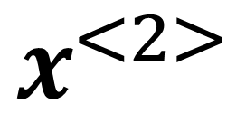
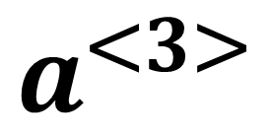
Recurrent Neural Network
Give a series of inputs $x^{<t>}, t=1,…,N$, a RNN is a model to receive every input and produce output $y^{<t>}$
RNN has internal state $a^{<t>}$
All time steps share the model parameters
$a^{<0>}$ is often initialized as 0
$${\hat{y}}^{<1>}$$
$${\hat{y}}^{<2>}$$
$${\hat{y}}^{<3>}$$
$${\hat{y}}^{<N>}$$
$${\hat{y}}^{<t>}$$
$$a^{<1>}$$
$$a^{<2>}$$
$$a^{<3>}$$
… …
$$a^{<N−1>}$$
$$a^{<0>}$$
$$a^{<0>}$$
$$x^{<1>}$$
$$x^{<2>}$$
$$x^{<3>}$$
$$x^{<N>}$$
$$x^{<t>}$$
unrolled along time

Slide 6
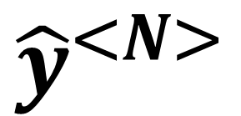
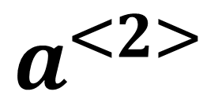
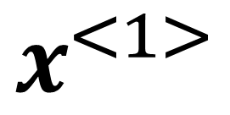
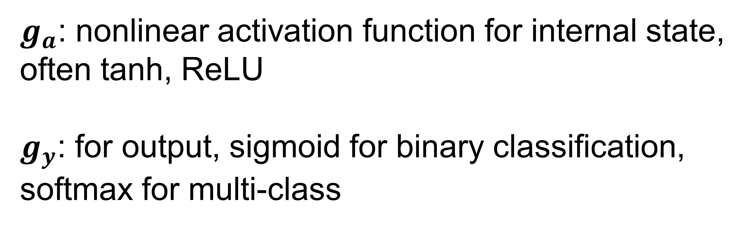
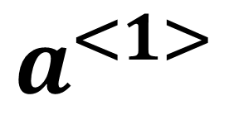
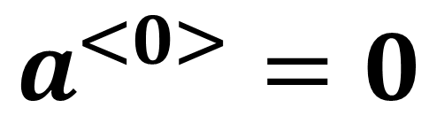
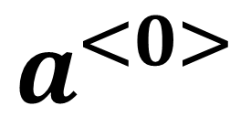
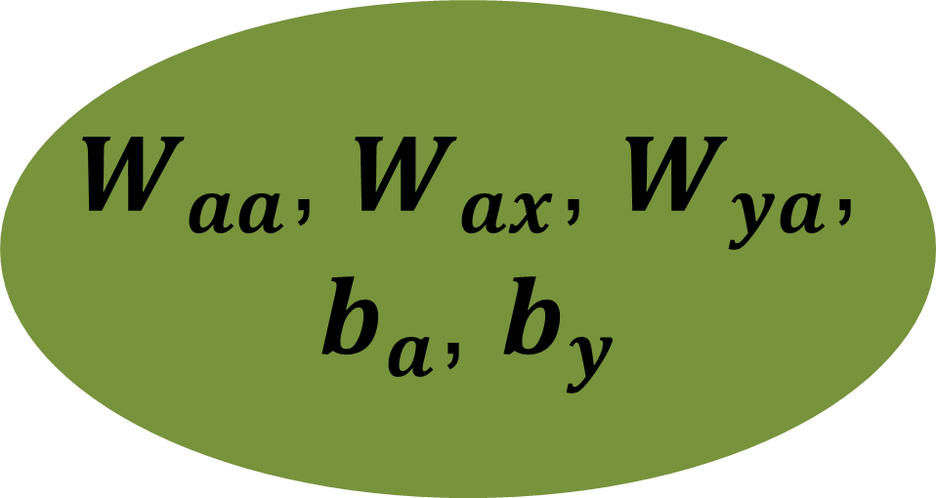
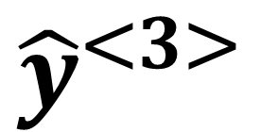
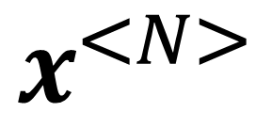
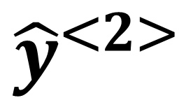
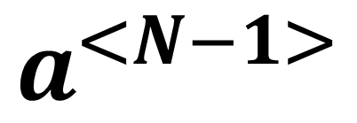
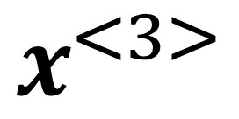
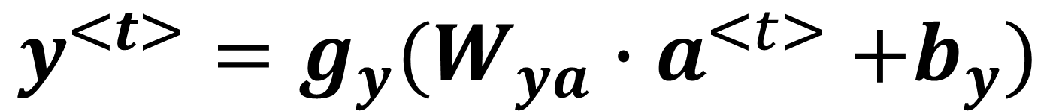
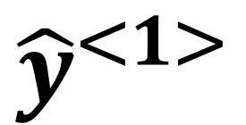
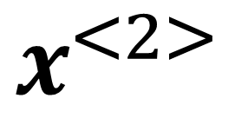
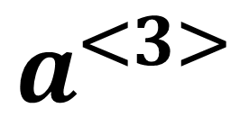
Recurrent Neural Network
input $x^{<t>}, t=1,…,N$, output $y^{<t>}$
internal state $a^{<t>}$
$${\hat{y}}^{<1>}$$
$${\hat{y}}^{<2>}$$
$${\hat{y}}^{<3>}$$
$${\hat{y}}^{<N>}$$
$$a^{<1>}$$
$$a^{<2>}$$
$$a^{<3>}$$
… …
$$a^{<N−1>}$$
$$a^{<0>}=0$$
$$a^{<0>}$$
$$a^{<t>}=g_{a}(W_{aa}{∙a}^{<t−1>}+W_{ax}{∙x}^{<t>}+b_{a})$$
$$y^{<t>}=g_{y}(W_{ya}{∙a}^{<t>}+b_{y})$$
$$x^{<1>}$$
$$x^{<2>}$$
$$x^{<3>}$$
$$x^{<N>}$$
$g_{a}$: nonlinear activation function for internal state,
often tanh, ReLU
$g_{y}$: for output, sigmoid for binary classification,
softmax for multi-class
$W_{aa}$, $W_{ax}$, $W_{ya}$,
$b_{a}$, $b_{y}$
“Elman RNN”
Elman, Jeffrey L. (1990). "Finding Structure in Time". Cognitive Science. 14 (2): 179–211. doi:10.1016/0364-0213(90)90002-E
$${Jordan RNN: a}^{<t>}=g_{a}(W_{aa}{∙a}^{<t−1>}+W_{ax}{∙y}^{<t−1>}+b_{a})$$
Jordan, Michael I. (1997-01-01). "Serial Order: A Parallel Distributed Processing Approach". Neural-Network Models of Cognition - Biobehavioral Foundations. Advances in Psychology. Neural-Network Models of Cognition. 121. pp. 471–495.

Slide 7
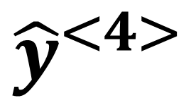
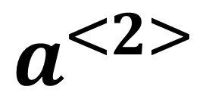
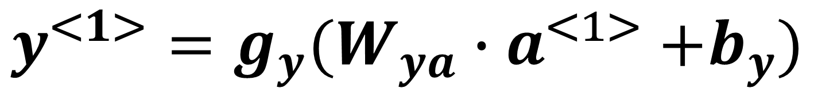
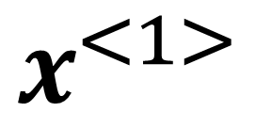
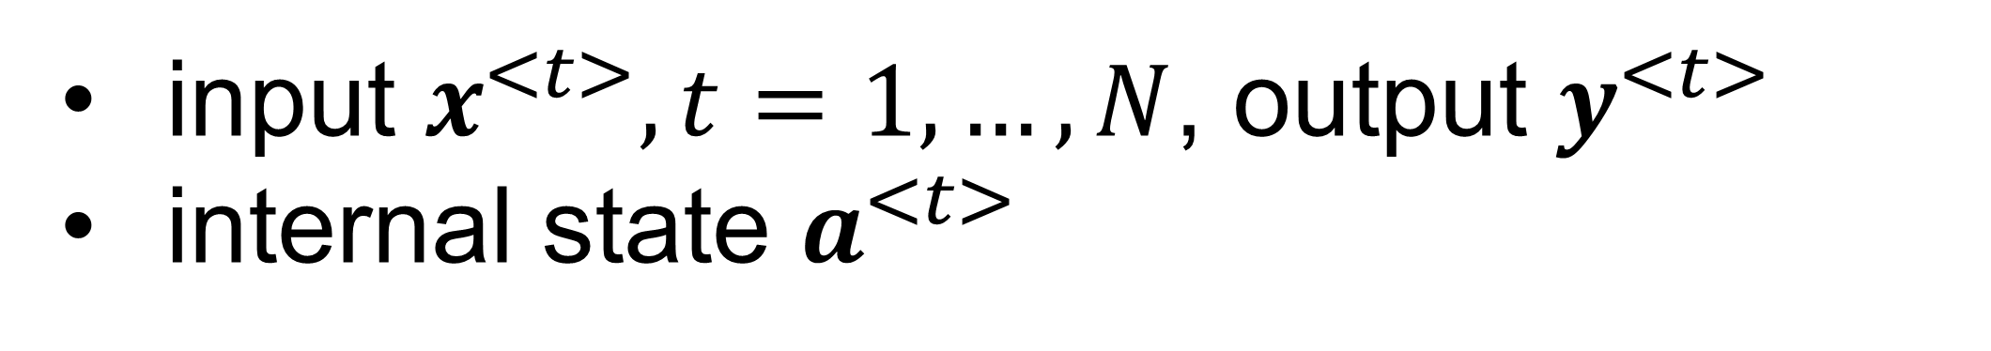
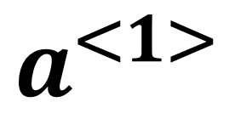
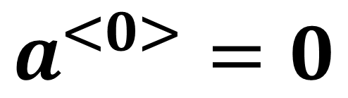
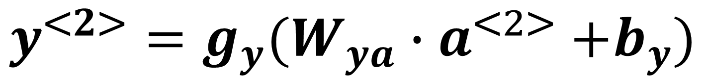
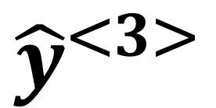
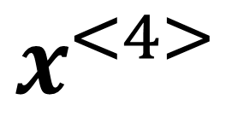
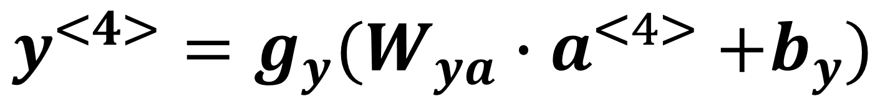







Recurrent Neural Network: Forward pass
input $x^{<t>}, t=1,…,N$, output $y^{<t>}$
internal state $a^{<t>}$
$${\hat{y}}^{<1>}$$
$${\hat{y}}^{<2>}$$
$${\hat{y}}^{<3>}$$
$${\hat{y}}^{<4>}$$
$$a^{<0>}=0$$
$$a^{<1>}=g_{a}(W_{aa}{∙a}^{<0>}+W_{ax}{∙x}^{<1>}+b_{a})$$
$$a^{<1>}$$
$$a^{<2>}$$
$$a^{<3>}$$
$$a^{<0>}$$
$$y^{<1>}=g_{y}(W_{ya}{∙a}^{<1>}+b_{y})$$
$$a^{<2>}=g_{a}(W_{aa}{∙a}^{<1>}+W_{ax}{∙x}^{<2>}+b_{a})$$
$$y^{<2>}=g_{y}(W_{ya}{∙a}^{<2>}+b_{y})$$
$$x^{<1>}$$
$$x^{<2>}$$
$$x^{<3>}$$
$$x^{<4>}$$
$$a^{<3>}=g_{a}(W_{aa}{∙a}^{<2>}+W_{ax}{∙x}^{<3>}+b_{a})$$
$$a^{<4>}=g_{a}(W_{aa}{∙a}^{<3>}+W_{ax}{∙x}^{<4>}+b_{a})$$
$$y^{<3>}=g_{y}(W_{ya}{∙a}^{<3>}+b_{y})$$
$$y^{<4>}=g_{y}(W_{ya}{∙a}^{<4>}+b_{y})$$

Slide 8
















Recurrent Neural Network: recurrent
input $x^{<t>}, t=1,…,N$, output $y^{<t>}$
internal state $a^{<t>}$
$${\hat{y}}^{<1>}$$
$${\hat{y}}^{<2>}$$
$${\hat{y}}^{<3>}$$
$${\hat{y}}^{<4>}$$
$$a^{<0>}=0$$
$$a^{<1>}$$
$$a^{<2>}$$
$$a^{<3>}$$
$$a^{<4>}$$
$$a^{<0>}$$
$$a^{<t>}=g_{a}(W_{aa}{∙a}^{<t−1>}+W_{ax}{∙x}^{<t>}+b_{a})$$
$$x^{<1>}$$
$$x^{<2>}$$
$$x^{<3>}$$
$$x^{<4>}$$
$$a^{<4>}=g_{a}\left(W_{aa}{∙a}^{<3>}+W_{ax}{∙x}^{<4>}+b_{a}\right)$$
$$=g_{a}\left(W_{aa}∙[g_{a}(W_{aa}{∙a}^{<2>}+W_{ax}{∙x}^{<3>}+b_{a})]+W_{ax}{∙x}^{<4>}+b_{a}\right)$$
$$=g_{a}\left(W_{aa}∙[g_{a}(W_{aa}∙[g_{a}(W_{aa}{∙a}^{<1>}+W_{ax}{∙x}^{<2>}+b_{a})]+W_{ax}{∙x}^{<3>}+b_{a})]+W_{ax}{∙x}^{<4>}+b_{a}\right)$$
$$=g_{a}\left(W_{aa}∙[g_{a}(W_{aa}∙[g_{a}(W_{aa}∙[g_{a}(W_{aa}{∙a}^{<0>}+W_{ax}{∙x}^{<1>}+b_{a})]+W_{ax}{∙x}^{<2>}+b_{a})]+W_{ax}{∙x}^{<3>}+b_{a})]+W_{ax}{∙x}^{<4>}+b_{a}\right)$$
$$y^{<4>}=g_{y}(W_{ya}{∙a}^{<4>}+b_{y})$$
Recurrently apply the model parameters to update internal state
$y^{<t>}$ depends on all inputs on or before current time step

Slide 9


















Recurrent Neural Network: loss
input $x^{<t>}, t=1,…,N$, output $y^{<t>}$
internal state $a^{<t>}$
$${\hat{y}}^{<1>}$$
$${\hat{y}}^{<2>}$$
$${\hat{y}}^{<3>}$$
$${\hat{y}}^{<4>}$$
$$a^{<0>}$$
$$a^{<1>}$$
$$a^{<2>}$$
$$a^{<3>}$$
$$a^{<4>}$$
Assume $y^{<t>}$ to take 0 or 1, e.g. like/dislike, binary classification
$$ℓ^{<t>}\left(y^{<t>},{\hat{y}}^{<t>}\right)=−y^{<t>}log({\hat{y}}^{<t>})−\left(1−y^{<t>}\right)log(1−{\hat{y}}^{<t>})$$
$$x^{<1>}$$
$$x^{<2>}$$
$$x^{<3>}$$
$$x^{<4>}$$
$$ℓ=\sum_{t=1}^{N}{ℓ^{<t>}\left(y^{<t>},{\hat{y}}^{<t>}\right)}$$
$$a^{<t>}=g_{a}(W_{aa}{∙a}^{<t−1>}+W_{ax}{∙x}^{<t>}+b_{a})$$
$$y^{<t>}=g_{y}(W_{ya}{∙a}^{<t>}+b_{y})$$
$$\frac{∂ℓ}{∂W_{aa}}=\sum_{t=1}^{N}{\frac{∂ℓ^{<t>}\left(y^{<t>},{\hat{y}}^{<t>}\right)}{W_{aa}}}$$
$$\frac{∂ℓ}{∂W_{ax}}=\sum_{t=1}^{N}{\frac{∂ℓ^{<t>}\left(y^{<t>},{\hat{y}}^{<t>}\right)}{W_{ax}}}$$
$$\frac{∂ℓ}{∂W_{ya}}=\sum_{t=1}^{N}{\frac{∂ℓ^{<t>}\left(y^{<t>},{\hat{y}}^{<t>}\right)}{W_{ya}}}$$
… …

Slide 10

























Recurrent Neural Network: backprop through time
$$ℓ$$
$$\frac{∂ℓ}{∂W_{aa}}=\sum_{t=1}^{N}{\frac{∂ℓ^{<t>}\left(y^{<t>},{\hat{y}}^{<t>}\right)}{W_{aa}}}$$
$$ℓ^{<1>}$$
$$ℓ^{<2>}$$
$$ℓ^{<3>}$$
$$ℓ^{<4>}$$
$$y^{<1>}$$
$$y^{<2>}$$
$$y^{<3>}$$
$$y^{<4>}$$
$$a^{<t>}=g_{a}(W_{aa}{∙a}^{<t−1>}+W_{ax}{∙x}^{<t>}+b_{a})$$
$${\hat{y}}^{<1>}$$
$${\hat{y}}^{<2>}$$
$${\hat{y}}^{<3>}$$
$${\hat{y}}^{<4>}$$
$$y^{<t>}=g_{y}(W_{ya}{∙a}^{<t>}+b_{y})$$
$$a^{<1>}$$
$$a^{<2>}$$
$$a^{<3>}$$
$$a^{<4>}$$
$$a^{<0>}$$
from t=1,2,3,4
from t=2,3,4
from t=3,4
$$x^{<1>}$$
$$x^{<2>}$$
$$x^{<3>}$$
$$x^{<4>}$$
$$W_{aa}$$
from t=4

Slide 11













Recurrent Neural Network: variants
$${\hat{y}}^{<1>}$$
$${\hat{y}}^{<2>}$$
$${\hat{y}}^{<3>}$$
$${\hat{y}}^{<N>}$$
$$a^{<1>}$$
$$a^{<2>}$$
$$a^{<3>}$$
… …
$$a^{<N−1>}$$
$$a^{<0>}$$
Many-to-many, same length
e.g. trigger word detection
$$x^{<1>}$$
$$x^{<2>}$$
$$x^{<3>}$$
$$x^{<N>}$$

Slide 12

Recurrent Neural Network: variants
$$\hat{y}$$
$$a^{<1>}$$
$$a^{<2>}$$
$$a^{<3>}$$
… …
$$a^{<N−1>}$$
$$a^{<0>}$$
Many-to-one, causal
e.g. video grading system
$$x^{<1>}$$
$$x^{<2>}$$
$$x^{<3>}$$
$$x^{<N>}$$

Slide 13

Recurrent Neural Network: variants
Global pooling
$$\hat{y}$$
$${\hat{y}}^{<1>}$$
$${\hat{y}}^{<2>}$$
$${\hat{y}}^{<3>}$$
… …
$${\hat{y}}^{<N>}$$
$$a^{<1>}$$
$$a^{<2>}$$
$$a^{<3>}$$
… …
$$a^{<N−1>}$$
$$a^{<0>}$$
Many-to-one, non-causal
e.g. video grading system
Better balanced for all time steps
$$x^{<1>}$$
$$x^{<2>}$$
$$x^{<3>}$$
$$x^{<N>}$$

Slide 14
Recurrent Neural Network: variants
$${\hat{y}}^{<1>}$$
$${\hat{y}}^{<2>}$$
$${\hat{y}}^{<3>}$$
… …
$${\hat{y}}^{<N>}$$
$$a^{<1>}$$
$$a^{<2>}$$
$$a^{<3>}$$
… …
$$a^{<N−1>}$$
$$a^{<0>}$$
One-to-many
e.g. music or video generator, with input being a latent variable
$$x^{<1>}$$
Self-regression: Sample from distribution ${\hat{y}}^{<t>}$ and feed it as the next $x^{<t>}$, until <EOS> token is reached np.random.choice(p=prob)

Slide 15










Recurrent Neural Network: variants
$${\hat{y}}^{<1>}$$
$${\hat{y}}^{<2>}$$
$${\hat{y}}^{<3>}$$
… …
$${\hat{y}}^{<N>}$$
$$a^{<1>}$$
$$a^{<2>}$$
$$a^{<3>}$$
… …
$$a^{<N−1>}$$
$$a^{<0>}$$
$$x^{<1>}$$
$${P({\hat{y}}^{<1>},{\hat{y}}^{<2>},{\hat{y}}^{<3>},…,\hat{y}}^{<N>})$$
$$=P\left({\hat{y}}^{<1>}\left|x^{<1>}\right.\right)P\left({\hat{y}}^{<2>}\left|{\hat{y}}^{<1>}\right.\right)P\left({\hat{y}}^{<3>}\left|{\hat{y}}^{<1>},{\hat{y}}^{<2>}\right.\right)…P\left({\hat{y}}^{<N>}\left|{\hat{y}}^{<1>},…,{\hat{y}}^{<N−1>}\right.\right)$$
Chain rule of joint probability

Slide 16

Recurrent Neural Network: input label and seq
$${\hat{y}}^{<1>}$$
$${\hat{y}}^{<2>}$$
$${\hat{y}}^{<3>}$$
… …
$${\hat{y}}^{<N>}$$
$$a^{<1>}$$
$$a^{<2>}$$
$$a^{<3>}$$
… …
$$a^{<N−1>}$$
$$label$$
One-to-many
e.g. music, with input being a latent variable and label being its style (classical, pop, …)
$$x^{<1>}$$

Slide 17














Recurrent Neural Network: encoder-decoder
$${\hat{y}}^{<1>}$$
$${\hat{y}}^{<2>}$$
$${\hat{y}}^{<3>}$$
… …
$${\hat{y}}^{<M>}$$
encoder
… …
$$a^{<1>}$$
$$a^{<2>}$$
$$a^{<3>}$$
$$a^{<N−1>}$$
$$a^{<0>}$$
…
$$a^{<N>}$$
decoder
$$x^{<1>}$$
$$x^{<2>}$$
$$x^{<3>}$$
$$x^{<N>}$$
Many-to-many, variable length
e.g. machine translation, video captioning

Slide 18

















Recurrent Neural Network: vanishing gradient
$$ℓ$$
$$ℓ^{<N>}$$
$${\hat{y}}^{<1>}$$
$${\hat{y}}^{<2>}$$
$${\hat{y}}^{<N>}$$
$$y^{<N>}$$
$$a^{<1>}=$$
$$g_{a}(W_{aa}{∙a}^{<0>}+W_{ax}{∙x}^{<1>}+b_{a})$$
$$a^{<2>}=$$
$$g_{a}(W_{aa}{∙a}^{<0>}+W_{ax}{∙x}^{<1>}+b_{a})$$
$$a^{<N>}=$$
$$g_{a}(W_{aa}{∙a}^{<N−1>}+W_{ax}{∙x}^{<N>}+b_{a})$$
$$y^{<N>}=g_{y}(W_{ya}{∙a}^{<N>}+b_{y})$$
$$a^{<1>}$$
$$a^{<2>}$$
… …
$$a^{<N−1>}$$
$$a^{<0>}$$
In theory, remember all history
In reality, remember short history
$$x^{<1>}$$
$$x^{<2>}$$
$$x^{<N>}$$
$${\frac{∂ℓ^{<N>}}{∂W_{aa}}|}_{t=1}=\frac{∂ℓ^{<N>}}{∂{\hat{y}}^{<N>}}\frac{∂{\hat{y}}^{<N>}}{∂a^{<N>}}\frac{∂a^{<N>}}{∂a^{<N−1>}}…\frac{∂a^{<2>}}{∂a^{<1>}}\frac{∂a^{<1>}}{∂W_{aa}}$$
$$a^{<N>}=$$
$$g_{a}(W_{aa}{∙a}^{<N−1>}+W_{ax}{∙x}^{<N>}+b_{a})$$

Slide 19



Recurrent Neural Network: vanishing gradient
$${\frac{∂ℓ^{<N>}}{∂W_{aa}}|}_{t=1}=\frac{∂ℓ^{<N>}}{∂{\hat{y}}^{<N>}}\frac{∂{\hat{y}}^{<N>}}{∂a^{<N>}}\frac{∂a^{<N>}}{∂a^{<N−1>}}…\frac{∂a^{<2>}}{∂a^{<1>}}\frac{∂a^{<1>}}{∂W_{aa}}$$
$$a^{<N>}=$$
$$g_{a}(W_{aa}{∙a}^{<N−1>}+W_{ax}{∙x}^{<N>}+b_{a})$$
$$\frac{∂a^{<N>}}{∂a^{<N−1>}}=W_{aa}∙g_{a}^{′} (W_{aa}{∙a}^{<N−1>}+W_{ax}{∙x}^{<N>}+b_{a})$$
$${\frac{∂ℓ^{<N>}}{∂W_{aa}}|}_{t=1}=\frac{∂ℓ^{<N>}}{∂{\hat{y}}^{<N>}}\frac{∂{\hat{y}}^{<N>}}{∂a^{<N>}}\left[\prod_{t=2}^{N}{\frac{∂a^{<t>}}{∂a^{<t−1>}}}\right]\frac{∂a^{<1>}}{∂W_{aa}}$$
$$=\frac{∂ℓ^{<N>}}{∂{\hat{y}}^{<N>}}\frac{∂{\hat{y}}^{<N>}}{∂a^{<N>}}{W_{aa}}^{N−1}\left[\prod_{t=2}^{N}{g_{a}^{′} (W_{aa}{∙a}^{<t−1>}+W_{ax}{∙x}^{<t>}+b_{a})}\right]\frac{∂a^{<1>}}{∂W_{aa}}$$

Slide 20



Recurrent Neural Network: vanishing gradient
$${\frac{∂ℓ^{<N>}}{∂W_{aa}}|}_{t=1}=\frac{∂ℓ^{<N>}}{∂{\hat{y}}^{<N>}}\frac{∂{\hat{y}}^{<N>}}{∂a^{<N>}}{W_{aa}}^{N−1}\left[\prod_{t=2}^{N}{g_{a}^{′} (W_{aa}{∙a}^{<t−1>}+W_{ax}{∙x}^{<t>}+b_{a})}\right]\frac{∂a^{<1>}}{∂W_{aa}}$$
Often cause vanishing gradient
If falling into the linear regime of tanh, then minimal eigen value of $W_{aa}$ comes into the play :
<1, vanishing gradient
>1 exploding gradient

Slide 21


Fix the unstable gradient: skip connections
Add skip-connections
Allow gradient flow to pass back to earlier layers
Network will learn to utilize these skip connections during training
Deep Residual Learning for Image Recognition. 2015. https://arxiv.org/abs/1512.03385
Visualizing the Loss Landscape of Neural Nets. https://arxiv.org/pdf/1712.09913.pdf

Slide 22















Invented much earlier for RNN
1995-1997: Long Short Term Memory cell (LSTM) was proposed.
$${\hat{y}}^{<t>}$$
$${\hat{y}}^{<t>}$$
$$g_{y}$$
$$W_{ya}\left(∗\right)$$
$$+b_{y}$$
$$a^{<t>}=$$
$$g_{a}(W_{aa}{∙a}^{<t−1>}+W_{ax}{∙x}^{<t>}+b_{a})$$
$$y^{<t>}=g_{y}(W_{ya}{∙a}^{<t>}+b_{y})$$
$$a^{<t−1>}$$
$$a^{<t>}$$
$$W_{aa}\left(∗\right)$$
$$+b_{a}$$
$$a^{<t−1>}$$
$$g_{a}$$
$$a^{<t>}$$
$$W_{ax}\left(∗\right)$$
$$x^{<t>}$$
$$x^{<t>}$$
LSTM can Solve Hard Long Time Lag Problems. Advances in Neural Information Processing Systems 9. 1997.

Slide 23

























Vanilla RNN: computing cell
$${\hat{y}}^{<1>}$$
$${\hat{y}}^{<2>}$$
$${\hat{y}}^{<3>}$$
$$g_{y}$$
$$g_{y}$$
$$g_{y}$$
$$W_{ya}\left(∗\right)$$
$$+b_{y}$$
$$W_{ya}\left(∗\right)$$
$$+b_{y}$$
$$W_{ya}\left(∗\right)$$
$$+b_{y}$$
$$W_{aa}\left(∗\right)$$
$$+b_{a}$$
$$W_{aa}\left(∗\right)$$
$$+b_{a}$$
$$W_{aa}\left(∗\right)$$
$$+b_{a}$$
$$a^{<0>}$$
$$g_{a}$$
$$a^{<1>}$$
$$g_{a}$$
$$a^{<2>}$$
$$g_{a}$$
$$W_{ax}\left(∗\right)$$
$$W_{ax}\left(∗\right)$$
$$W_{ax}\left(∗\right)$$
$$x^{<1>}$$
$$x^{<2>}$$
$$x^{<3>}$$

Slide 24


LSTM: introduce a memory cell
$$a^{<t>}=g_{a}(W_{aa}{∙a}^{<t−1>}+W_{ax}{∙x}^{<t>}+b_{a})$$
Vanilla RNN
$$y^{<t>}=g_{y}(W_{ya}{∙a}^{<t>}+b_{y})$$
Introduce a memory cell $c^{<t>}$
1) Compute candidate ${\tilde{c}}^{<t>}$ to update memory cell, with learnable parameters to control what to remember, and what to forget
$${\tilde{c}}^{<t>}=g_{c}(W_{ca}{∙a}^{<t−1>}+W_{cx}{∙x}^{<t>}+b_{c})$$
2) Add two gets to control whether to update memory cell or keep its previous states
$$c^{<t>}={U∘\tilde{c}}^{<t>}+{F∘c}^{<t−1>}$$
$F=σ(W_{fa}{∙a}^{<t−1>}+W_{fx}{∙x}^{<t>}+b_{f})$: forget gate
$U=σ(W_{ua}{∙a}^{<t−1>}+W_{ux}{∙x}^{<t>}+b_{u})$: update gate

Slide 25







LSTM: introduce a memory cell
LSTM
3) Add one output gate
$$a^{<t>}={O∘c}^{<t>}$$
$${\tilde{c}}^{<t>}=g_{c}(W_{ca}{∙a}^{<t−1>}+W_{cx}{∙x}^{<t>}+b_{c})$$
$O=σ(W_{oa}{∙a}^{<t−1>}+W_{ox}{∙x}^{<t>}+b_{o})$: output gate
$$c^{<t>}={U∘\tilde{c}}^{<t>}+{F∘c}^{<t−1>}$$
4) Compute output
$F=σ(W_{fa}{∙a}^{<t−1>}+W_{fx}{∙x}^{<t>}+b_{f})$: forget gate
$$y^{<t>}=g_{y}(W_{ya}{∙a}^{<t>}+b_{y})$$
$U=σ(W_{ua}{∙a}^{<t−1>}+W_{ux}{∙x}^{<t>}+b_{u})$: update gate
or
$$a^{<t>}={O∘c}^{<t>}$$
$$y^{<t>}=g_{y}(a^{<t>})$$
$O=σ(W_{oa}{∙a}^{<t−1>}+W_{ox}{∙x}^{<t>}+b_{o})$: output gate
$$y^{<t>}=g_{y}(W_{ya}{∙a}^{<t>}+b_{y})$$
$F$, $U$, $O$ are vectors, same size as memory cell
${U∘\tilde{c}}^{<t>}$, ${F∘c}^{<t−1>}$, ${O∘c}^{<t>}$: element-wise multiplication

Slide 26













LSTM: computing graph
$${\hat{y}}^{<t>}$$
LSTM
$$g_{y}$$
$$c^{<t>}$$
$${\tilde{c}}^{<t>}=g_{c}(W_{ca}{∙a}^{<t−1>}+W_{cx}{∙x}^{<t>}+b_{c})$$
$$c^{<t−1>}$$
$$c^{<t>}={U∘\tilde{c}}^{<t>}+{F∘c}^{<t−1>}$$
$$F$$
$$W_{ya}\left(∗\right)$$
$$+b_{y}$$
$F=σ(W_{fa}{∙a}^{<t−1>}+W_{fx}{∙x}^{<t>}+b_{f})$: forget gate
$$O$$
$$a^{<t>}$$
$U=σ(W_{ua}{∙a}^{<t−1>}+W_{ux}{∙x}^{<t>}+b_{u})$: update gate
$$a^{<t−1>}$$
stack
$$a^{<t>}={O∘c}^{<t>}$$
$$U$$
$O=σ(W_{oa}{∙a}^{<t−1>}+W_{ox}{∙x}^{<t>}+b_{o})$: output gate
$$y^{<t>}=g_{y}(W_{ya}{∙a}^{<t>}+b_{y})$$
$$\tilde{c}$$
$$x^{<t>}$$
LSTM can Solve Hard Long Time Lag Problems. Advances in Neural Information Processing Systems 9. 1997.

Slide 27
LSTM: peephole connection
Add the memory cell state to the computation of gates
$F=σ(W_{fa}{∙a}^{<t−1>}+W_{fx}{∙x}^{<t>}+b_{f})$: forget gate
$U=σ(W_{ua}{∙a}^{<t−1>}+W_{ux}{∙x}^{<t>}+b_{u})$: update gate
$O=σ(W_{oa}{∙a}^{<t−1>}+W_{ox}{∙x}^{<t>}+b_{o})$: output gate
$F=σ(W_{fa}{∙a}^{<t−1>}+W_{fx}{∙x}^{<t>}+W_{fc}{∙c}^{<t−1>}+b_{f})$: forget gate
$U=σ(W_{ua}{∙a}^{<t−1>}+W_{ux}{∙x}^{<t>}+W_{uc}{∙c}^{<t−1>}+b_{u})$: update gate
$O=σ(W_{oa}{∙a}^{<t−1>}+W_{ox}{∙x}^{<t>}+W_{oc}{∙c}^{<t−1>}+b_{o})$: output gate

Slide 28


LSTM: convolution version, convLSTM
Replace linear matrix multiplication with the convolution and flatten/reshape
$F=σ(W_{fa}{∗a}^{<t−1>}+W_{fx}{∗x}^{<t>}+W_{fc}{∙c}^{<t−1>}+b_{f})$: forget gate
$U=σ(W_{ua}{∗a}^{<t−1>}+W_{ux}{∗x}^{<t>}+W_{uc}{∙c}^{<t−1>}+b_{u})$: update gate
$O=σ(W_{oa}{∗a}^{<t−1>}+W_{ox}{∗x}^{<t>}+W_{oc}{∙c}^{<t−1>}+b_{o})$: output gate
$${\tilde{c}}^{<t>}=g_{c}(W_{ca}{∗a}^{<t−1>}+W_{cx}{∗x}^{<t>}+b_{c})$$
$$c^{<t>}={U∘\tilde{c}}^{<t>}+{F∘c}^{<t−1>}$$
$a^{<t>}$, $x^{<t>}$ are images
$∗$ : image convolution
After convolution, results are flattened to be a vector
https://papers.nips.cc/paper/2015/file/07563a3fe3bbe7e3ba84431ad9d055af-Paper.pdf
https://towardsdatascience.com/video-prediction-using-convlstm-with-pytorch-lightning-27b195fd21a2

Slide 29



LSTM: many faces
https://colah.github.io/posts/2015-08-Understanding-LSTMs/
https://github.com/dlvu/dlvu.github.io/blob/main/slides/dlvu.lecture05.pdf
https://en.wikipedia.org/wiki/Long_short-term_memory#cite_note-43

Slide 30















GRU: Gated Recurrent Unit
$${\hat{y}}^{<t>}$$
GRU
$$g_{y}$$
$${(1−U)∙c}^{<t>}$$
$${\tilde{c}}^{<t>}=g_{c}(W_{ca}{∙R∘a}^{<t−1>}+W_{cx}{∙x}^{<t>}+b_{c})$$
$$1−U$$
$$W_{ya}\left(∗\right)$$
$$+b_{y}$$
$$c^{<t>}={U∘\tilde{c}}^{<t>}+{(1−U)∘c}^{<t−1>}$$
$F=1−U$: forget gate
$$a^{<t−1>}$$
$$a^{<t>}$$
$U=σ(W_{ua}{∙a}^{<t−1>}+W_{ux}{∙x}^{<t>}+b_{u})$: update gate
$${U∙\tilde{c}}^{<t>}$$
$$a^{<t>}=c^{<t>}$$
$$U$$
$O=σ(W_{oa}{∙a}^{<t−1>}+W_{ox}{∙x}^{<t>}+b_{o})$: output gate
$$\tilde{c}$$
$$R$$
$R=σ(W_{ra}{∙a}^{<t−1>}+W_{rx}{∙x}^{<t>}+b_{r})$: relevant gate
$$y^{<t>}=g_{y}(W_{ya}{∙a}^{<t>}+b_{y})$$
$$x^{<t>}$$
Learning phrase representations using RNN encoder-decoder for statistical machine translation. 2014. https://arxiv.org/abs/1406.1078

Slide 31

Other variants
More than ten thousand architectures
Different sequence tasks
“We have evaluated a variety of recurrent neural network architectures in order to find an architecture that reliably outperforms the LSTM. Though there were architectures that outperformed the LSTM on some problems, we were unable to find an architecture that consistently beat the LSTM and the GRU in all experimental conditions.”
An Empirical Exploration of Recurrent Network Architectures. 2015. http://proceedings.mlr.press/v37/jozefowicz15.pdf

Slide 32


Auto ML to find RNN cell
Require large computing resource
Can find better architecture on given tasks
https://lilianweng.github.io/lil-log/2020/08/06/neural-architecture-search.html
Neural Architecture Search with Reinforcement Learning. 2017.

Slide 33


















Bidirectional RNN (BRNN)
$${\hat{y}}^{<1>}$$
$${\hat{y}}^{<2>}$$
$${\hat{y}}^{<3>}$$
$${\hat{y}}^{<N>}$$
Some applications provide the entire series, e.g. machine translation
Or, the deployment does not require real-time processing
Allow utilize information from the past and the future
$${\overset{⃑}{a}}^{<1>}$$
$${\overset{⃑}{a}}^{<2>}$$
$${\overset{⃑}{a}}^{<3>}$$
… …
$${\overset{⃑}{a}}^{<N>}$$
$${\overset{⃑}{a}}^{<0>}$$
… …
$${\overset{⃐}{a}}^{<N+1>}$$
$${\overset{⃐}{a}}^{<1>}$$
$${\overset{⃐}{a}}^{<2>}$$
$${\overset{⃐}{a}}^{<3>}$$
$${\overset{⃐}{a}}^{<N>}$$
$$x^{<1>}$$
$$x^{<2>}$$
$$x^{<3>}$$
$$x^{<N>}$$
$$y^{<t>}=g_{y}(W_{ya}{∙[\overset{⃑}{a}}^{<t>};{\overset{⃐}{a}}^{<t>}]+b_{y})$$
or
$$y^{<t>}=g_{y}(W_{ya}{∙(\overset{⃑}{a}}^{<t>}+{\overset{⃐}{a}}^{<t>})+b_{y})$$

Slide 34











Bidirectional RNN (BRNN)
Still acyclic graph
Can run forward-pass and backprop
Supported by PyTorch or Keras
$${\overset{⃐}{a}}^{<1>}$$
$${\overset{⃑}{a}}^{<1>}$$
$${\overset{⃑}{a}}^{<2>}$$
$${\overset{⃐}{a}}^{<2>}$$
$$x^{<1>}$$
$${\overset{⃑}{a}}^{<3>}$$
$${\overset{⃐}{a}}^{<3>}$$
$$x^{<4>}$$
$${\overset{⃑}{a}}^{<4>}$$
$${\overset{⃐}{a}}^{<4>}$$
Two independent RNN put together
Equivalent to run two RNNs; one is fed with t=1,…,N and another is fed with t=N,N-1, …, 1

Slide 35

































Multi-layer RNN or deep RNN
$${\hat{y}}^{<1>}$$
$${\hat{y}}^{<2>}$$
$${\hat{y}}^{<3>}$$
… …
$${\hat{y}}^{<N>}$$
$$a^{[l]<t>}=g_{a}(W_{aa}^{[l]}{∙a}^{[l]<t−1>}+W_{ax}^{[l]}{∙\hat{y}}^{[l−1]<t>}+b_{a}^{[l]})$$
$$a^{[3]<1>}$$
$$a^{[3]<2>}$$
$$a^{[3]<3>}$$
… …
$$a^{[3]<N−1>}$$
$$a^{[3]<0>}$$
$$y^{[l]<t>}=g_{y}(W_{ya}^{[l]}{∙a}^{[l]<t>}+b_{y}^{[l]})$$
$${\hat{y}}^{[2]<1>}$$
$${\hat{y}}^{[2]<2>}$$
$${\hat{y}}^{[2]<3>}$$
$${\hat{y}}^{[2]<N>}$$
$$a^{[2]<1>}$$
$$a^{[2]<2>}$$
$$a^{[2]<3>}$$
… …
$$a^{[2]<N−1>}$$
$$a^{[2]<0>}$$
$${\hat{y}}^{[1]<1>}$$
$${\hat{y}}^{[1]<2>}$$
$${\hat{y}}^{[1]<3>}$$
$${\hat{y}}^{[1]<N>}$$
$$a^{[1]<1>}$$
$$a^{[1]<2>}$$
$$a^{[1]<3>}$$
… …
$$a^{[1]<N−1>}$$
$$a^{[1]<0>}$$
$$x^{<1>}$$
$$x^{<2>}$$
$$x^{<3>}$$
$$x^{<N>}$$

Slide 36
Multi-layer RNN or deep RNN
$${\hat{y}}^{<1>}$$
$${\hat{y}}^{<2>}$$
$${\hat{y}}^{<3>}$$
… …
$${\hat{y}}^{<N>}$$
… …
… …
… …
… …
… …
… …
$$x^{<1>}$$
$$x^{<2>}$$
$$x^{<3>}$$
$$x^{<N>}$$

Slide 37
Sequence pre-processing
This is a picture showing kids are playing.
Use one-hot encoding for words
Word level vocabulary:
[
a 0
aa 1
…
air
…
is 2876
…
grass
…
this
…
playing 27890
…
zinc
]
Word 1
Word 2
10K-30K entries in English vocabulary
Assume all words are orthogonal to each other
Does not utilize any “pre-training”
Length of vocabulary

Slide 38

Sequence pre-processing
Character level vocabulary:
Use one-hot encoding for characters
Often use compact representation:
This is a picture showing kids are playing.
T: 27 | h:12 | i:13 | s:23 | … …

Slide 39













Use character vocabulary
Hello!
$$e$$
$$l$$
$$l$$
$$o$$
$$!$$
$$<EOS>$$
Casual training
Finish with <EOS> token
$$a^{<0>}$$
$$H$$
$$e$$
$$l$$
$$l$$
$$o$$
$$!$$

Slide 40












Word embedding
This is a picture showing kids are playing.
Use a real-value vector to represent words
This
kids
$$v=W×one_hot_vector$$
$W$: embedding_dim x num_embedding
$$v_{This}$$
$$v_{is}$$
$$v_{a}$$
$$v_{picture}$$
$$v_{showing}$$
$$v_{kids}$$
$$v_{are}$$
$$v_{playing}$$
Length of embedding
Embedding layer
This
is
a
picture
showing
kids
are
playing
W can be learned or pre-trained.

Slide 41





Word2Vec
This is a picture showing kids are playing.
showing
$$x$$
Skip-grams
Self-supervised learning
X : center word
Y: neighboring word
$$SoftMax$$
Train on a large corpse of texts
Map words to N-dimensional space
Learned semantic relationship between words
$e_{king}+{(e_{woman}−e}_{man})≈e_{queen}$
$$W×\left(∙\right)+b$$
Center | Context
picture | showing
picture | a
picture | is
picture | This
Embedding layer
picture
https://www.tensorflow.org/tutorials/representation/word2vec
Efficient Estimation of Word Representations in Vector Space.2013. https://arxiv.org/abs/1301.3781

Slide 42

Word2Vec : carry the accumulated “bias” of the world
http://wordbias.umiacs.umd.edu/

Slide 43

Sequence pre-processing
Multiple instances of sequences:
This is a picture showing kids are playing
8x1024 matrix
Today is a good day
5x1024 matrix
The boy is reading a book under the tree
9x1024 matrix
One instance of long sequence:

Slide 44
Sequence pre-processing
One instance of long sequence:
Split to equal length chunk

Slide 45
Sequence pre-processing
Multiple instances of sequences : padding to equal length
Time, N=6
pad with zeros or <EOS>

Slide 46

Sequence pre-processing
Multiple instances of sequences : padding to equal length, with sorting
Time
Sample 1
Sample 2
Batch 1
If data distribution is not biased by its length
Consider to reduce batch size for longer sequences
Batch 2
… …
Batch 3
Sample N
Batch 4

Slide 47




Temporal Convolution Network
Use convolution to process sequence data
Dilated + Casual convolution
Dilated convolution
$$\text{Receptive}\text{_}\text{length}\text{_}\text{in}\text{_}\text{time}=2^{L}(kernel_{size}−1)$$
Normal convolution
Casual convolution
Fast training, fast inference
Google Wavenet – text to audio generation, used in e.g. Amazon Alexa
https://deepmind.com/blog/article/wavenet-generative-model-raw-audio

